Slide 1
Name: Selma Sentissi Management Communication Workbook February 19, 2021

Slide 2
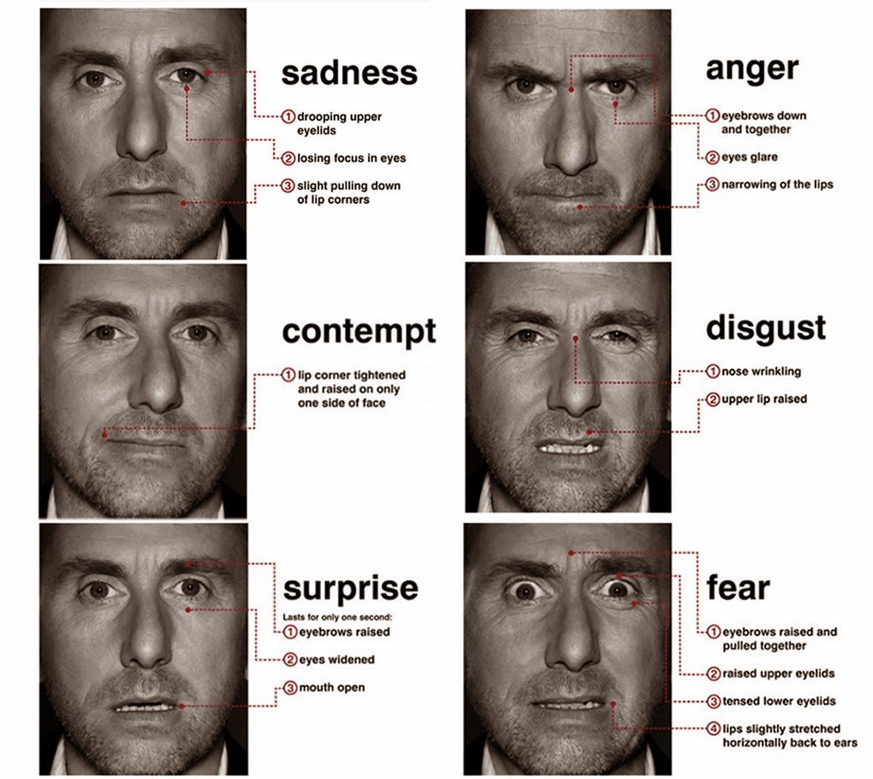
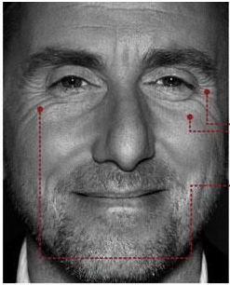
Match the emotion to the face
Anger - 2
Fear – 7
Disgust – 5
Surprise – 6
Contempt - 3
Sadness - 1
Happiness - 4

Slide 3

Talk about a passion in groups of 3
One person speaks about their passion for 3 minutes
One person listens and asks questions to encourage speaking
One person observes
Rotate roles

Slide 4
List 5 ways to optimize your body language, considering face, voice, and body
1. Hands behind the back
2. Elbow pop
3. Explode the steeple
4. Hand on your chin
5. Do not cross legs with the leg in front of the person closed

Slide 5
What are 5 ways to optimize your leadership or executive presence (i.e., your likability and warmth)?
1. Pay attention
2. Be curious
3. Put your cell phone away
4. Have casual conversations
5. Ask genuine questions

Slide 6
Watch the first minutes of these TED talks
Watch minutes 0 to 2:00 minutes of one talk
https://www.youtube.com/watch?v=nh94kK05l-M (Data is boring, people are interesting)
https://www.youtube.com/watch?v=c0KYU2j0TM4 (The power of introverts)
https://www.youtube.com/watch?v=Sm5xF-UYgdg (How not to be ignorant about the world)
https://www.ted.com/talks/amy_cuddy_your_body_language_may_shape_who_you_are?language=en https://www.youtube.com/watch?v=Ks-_Mh1QhMc (Your body language may shape who you are)
https://www.youtube.com/watch?v=plU-QpcEswo (Using your voice is a political choice)
https://www.ted.com/talks/kio_stark_why_you_should_talk_to_strangers?language=en (Why you should talk to strangers)
© 2007 McGraw-Hill Companies, Inc., McGraw-Hill/Irwin

Slide 7
What are ways to begin a TED talk?
1. Story
2. Ask the audience to vote
3.
4.
5.
© 2007 McGraw-Hill Companies, Inc., McGraw-Hill/Irwin

Slide 8
Watch the middle minutes of these TED talks
Watch 6:00 to 7:15 minutes
https://www.youtube.com/watch?v=rDiGYuQicpA (Averting the climate crisis)
Watch 6:45 to 9:30 minutes
https://www.youtube.com/watch?v=c0KYU2j0TM4 (The power of introverts)
Watch 8:55 to 10:50 minutes
https://www.youtube.com/watch?v=Sm5xF-UYgdg (How not to be ignorant about the world)
© 2007 McGraw-Hill Companies, Inc., McGraw-Hill/Irwin

Slide 9
What happens in the middle of a TED talk?
1. Present data to prove a point
2.
3.
4.
5.
© 2007 McGraw-Hill Companies, Inc., McGraw-Hill/Irwin

Slide 10
Watch the closing minutes of these TED talks
Watch 8:50 to 10 minutes
https://www.youtube.com/watch?v=rDiGYuQicpA (Averting the climate crisis)
Watch 16:30 to end
https://www.youtube.com/watch?v=c0KYU2j0TM4 (The power of introverts)
Watch 13:30 to 16:15 minutes
https://www.youtube.com/watch?v=Sm5xF-UYgdg (How not to be ignorant about the world)
© 2007 McGraw-Hill Companies, Inc., McGraw-Hill/Irwin

Slide 11
What happens at the end of a TED talk?
1. Summarize
2.
3.
4.
5.
© 2007 McGraw-Hill Companies, Inc., McGraw-Hill/Irwin

